Slide 1
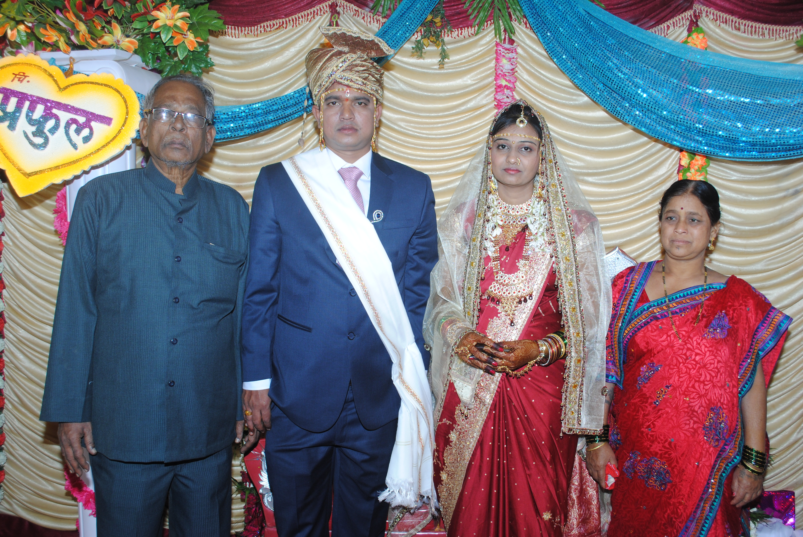
Got Married and also changed job to Tech Mahindra , Pune
Dad Mom Meghana Me on Feb 16, 2014

Slide 2
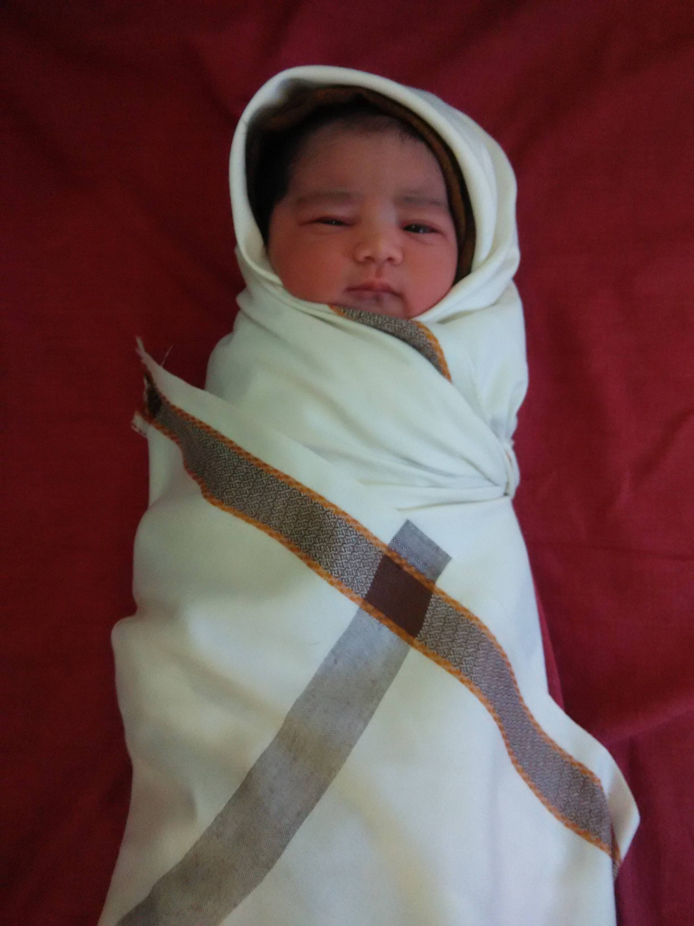
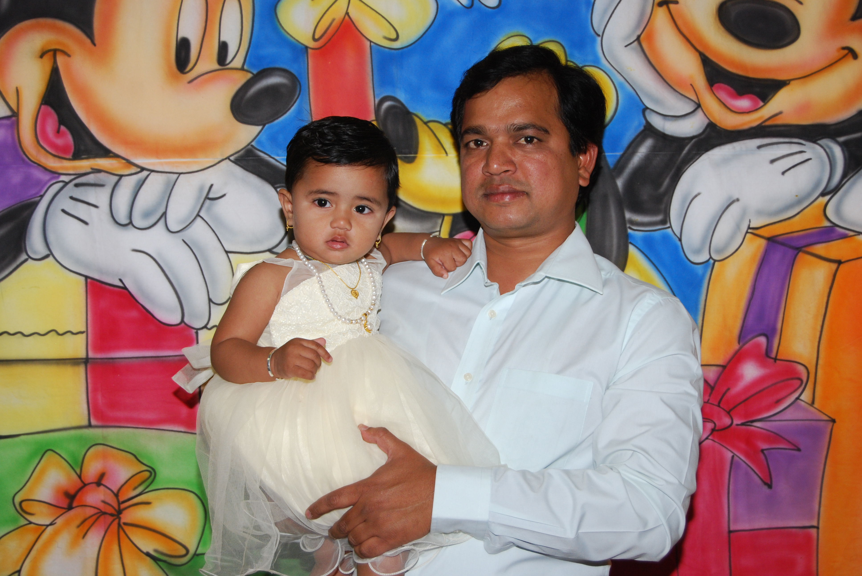
Feb 2016, Daughter born
Less than 1 hour old
1 year old

Slide 3
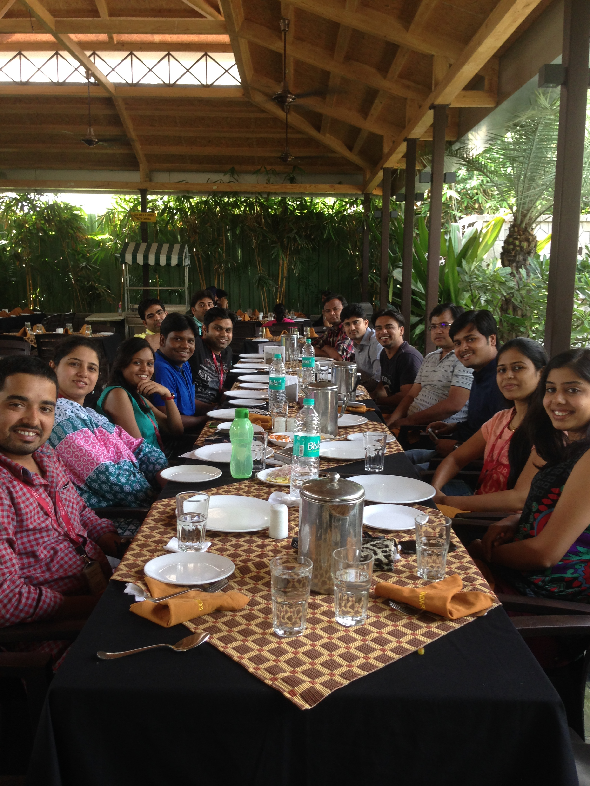
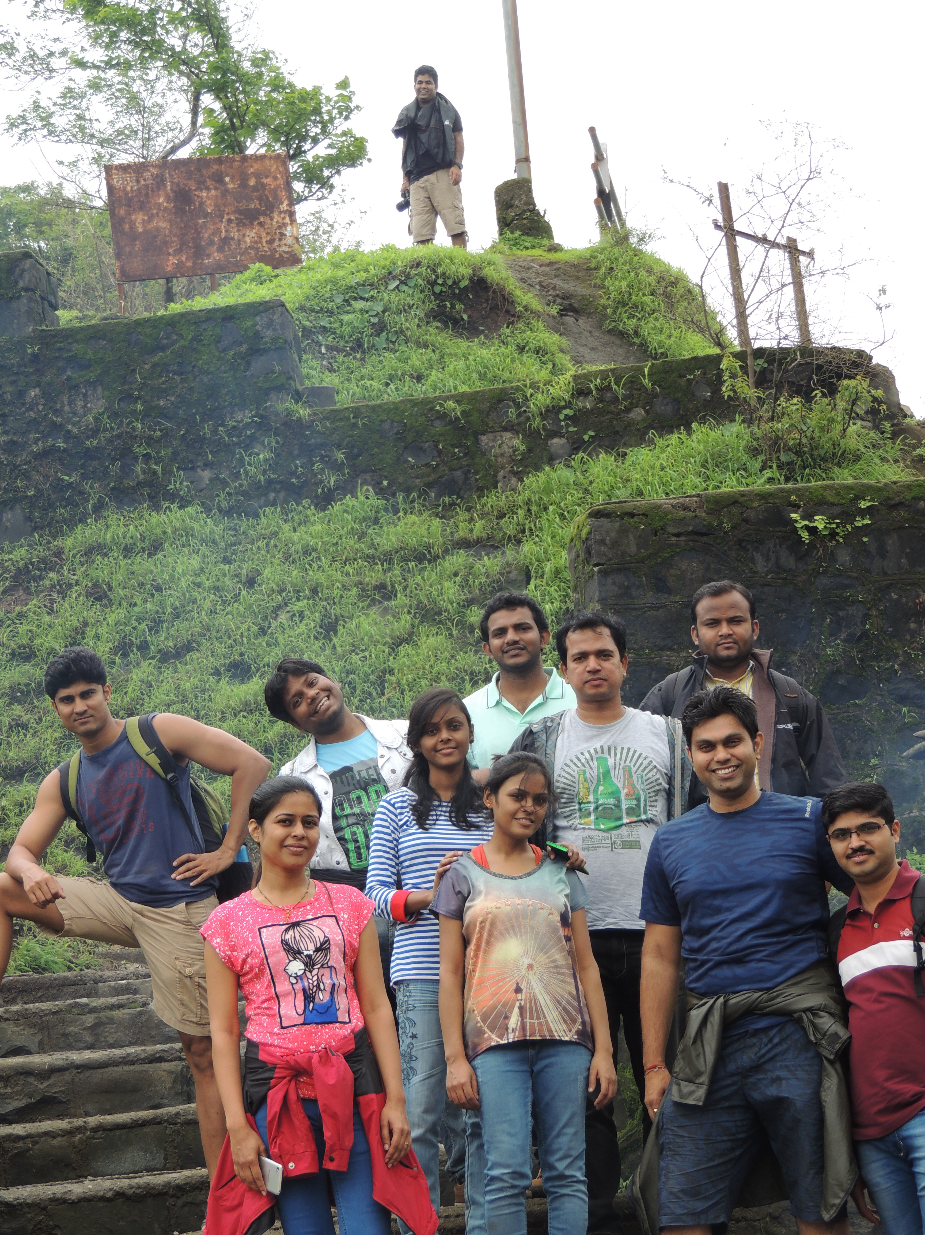
Worked at Tech Mahindra Pune for AT & T project from June 2014 to May 2017.

